Slide 1
Welcome to My presentation
Name : Sagor ray
ID : 20191135010
YEAR : 2nd
Semester : 3rd
Sec : D

Slide 2
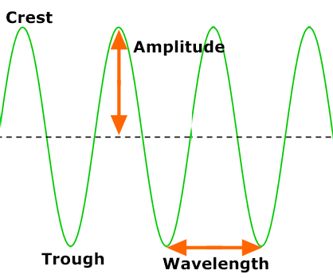
Introduction
What is light?
Light is an electromagnetic radiation refers to visible regions of electromagnetic spectrum corresponding to the wavelength range of 400nm to 760nm has transverse vibrations.

Slide 3
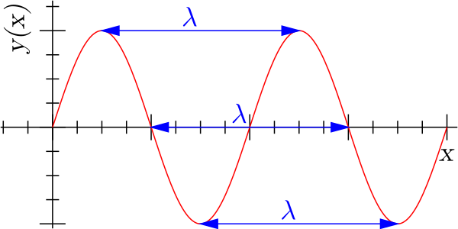
GENERAL DEFINITIONS
The wavelength of a sin wave λ, can be measured between any two points with the same phase, such as between crests, or troughs, as shown.
The frequency, f , of a wave is the number of waves passing a point in a certain time. We normally use a time of one second, so this gives frequency the unit hertz (Hz), since one hertz is equal to one wave per second.

Slide 4
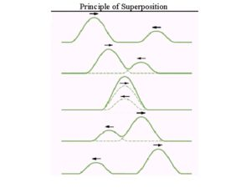
PRINCIPLE OF SUPERPOSITION
Whenever two or more waves superimpose in a medium, the total displacement at any point is equal to the vector sum of individual displacement of waves at that point.
If Y₁ , Y₂ , Y₃ …..are different displacement vector due to the waves 1, 2, 3 ......acting separately then according to the principle of superposition the resultant displacement is given by Y = Y₁ + Y₂ + Y₃ +…..

Slide 5
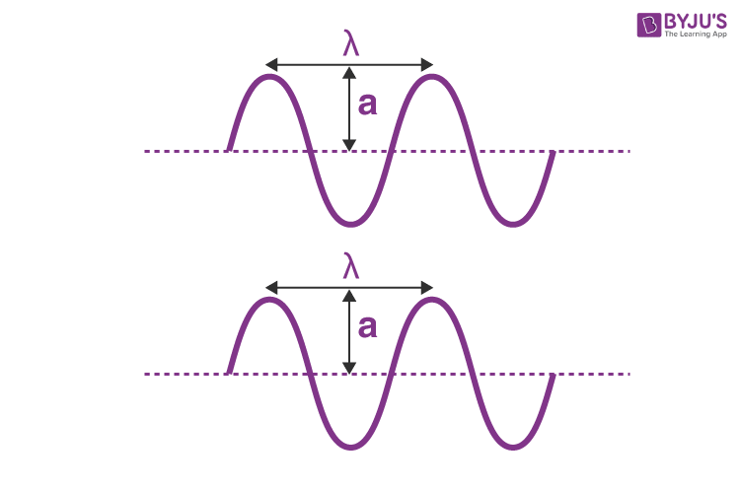
COHERENT SOURCE
Two sources are said to be coherent when the waves emitted from them have the same frequency and constant phase difference.
Coherent sources have the following characteristics:
The waves generated have a constant phase difference
The waves are of a single frequency

Slide 6
INTERFERENCE
Interference is a natural phenomenon that happens at every place and at every moment. Yet we don’t see interference patterns everywhere. Interference is the phenomenon in which two waves superpose to form the resultant wave of the lower, higher or same amplitude. The most commonly seen interference is the optical interference or light interference. This is because light waves are randomly generated every which way by most sources. This means that light waves coming out of a source do not have a constant amplitude, frequency or phase.

Slide 7
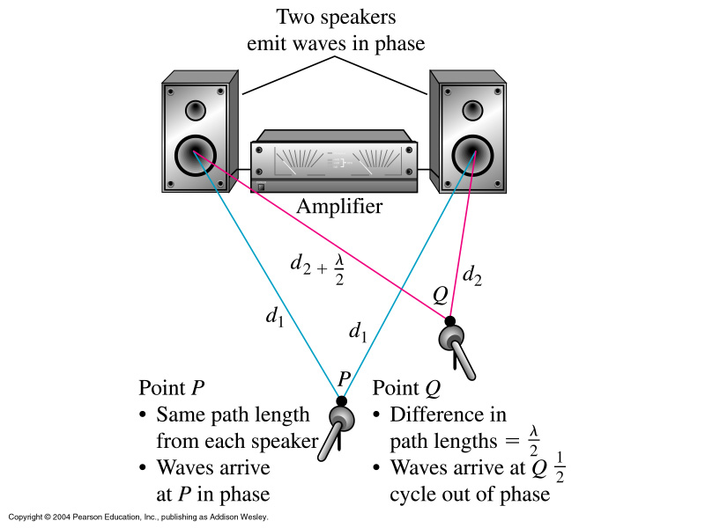
INTERFERENCE

Slide 8
TYPES OF INTERFERENCE
Interference of light waves can be either constructive interference or destructive interference.
Constructive interference: Constructive interference takes place when the crest of one wave falls on the crest of another wave such that the amplitude is maximum. These waves will have the same displacement and are in the same phase.
Destructive interference: In destructive interference the crest of one wave falls on the trough of another wave such that the amplitude is minimum. The displacement and phase of these waves are not the same.

Slide 9
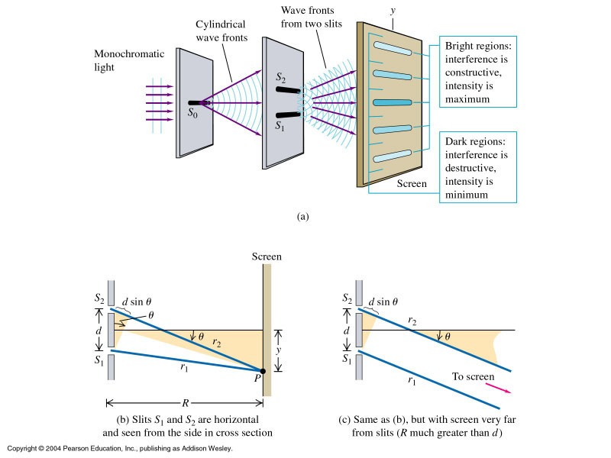
YOUNG’S DOUBLE SLIT EXPERIMENT
Demonstrates wave nature of light
Each slit S₁ and S₂ acts as a separate source of coherent light (like the loudspeakers for sound waves)

Slide 10
YOUNG’S DOUBLE SLIT EXPERIMENT
Assuming (justifiably) that R>>d, then lines r₂ and r₁ are approximately parallel, and path difference for the light from the 2 slits given by:

Slide 11
YOUNG’S DOUBLE SLIT EXPERIMENT
Constructive interference:
Destructive interference:

Slide 12
CONDITIONS FOR INTERFERENCE OF LIGHT WAVES
For sustained interference of light to occur, the following conditions must be met:
1. Coherent sources of light are needed.
2. Amplitudes and intensities must be nearly equal to produce sufficient contrast between maxima and minima.
3. The source must be small enough that it can be considered a point source of light.

Slide 13
CONDITIONS FOR INTERFERENCE OF LIGHT WAVES
4.The interfering sources must be near enough to produce wide fringes.
5. The source and screen must be far enough to produce wide fringes.
6. The sources must emit light in the same state of polarization.
7. The sources must be monochromatic.

Slide 14
CONCLUSION
Light behaves like a wave; interference
We used this property to calculate the wavelength of light
Light also behaves like a particle
This behavior is described in the dual wave/particle theory

Slide 15
THANK YOU

